Slide 1
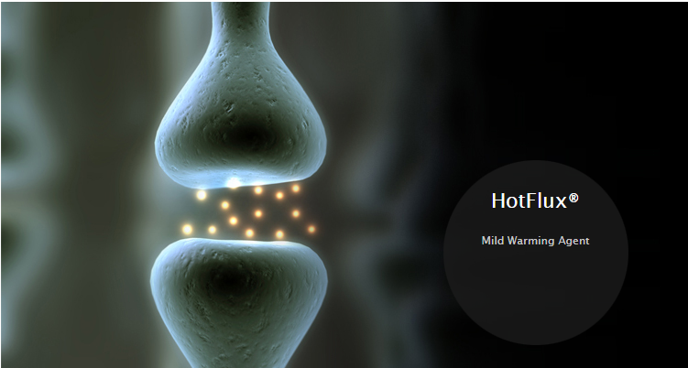
Product
HotFlux®
Delicate warming sensation & stronger hair promotion
Hair and Scalp care
Hair and scalp
Cooling / Warming
tags
INCI name: Vanillyl Butyl Ether
Chinese INCI:香蘭基丁基醚
HotFlux® is a vanillyl alcohol alkyl ether derivative that imparts an exotic, gentle and long-lasting warming sensation. It not only stimulates microcirculation and attenuate inflammatory response but also mitigates hair thinning and prevents hair loss. This ingredient can be introduced to psychological relaxation, pain relief, slimming, intimacy, as well as scalp care and anti-hair loss products.
Efficacy
In vitro | In vivo
Inhibits 5-alpha reductase activity Increases essential growth factors Reduces inflammatory cytokines induced by air pollutants | Induces warming sensation Enhances microcirculation The ratio of hair anagen/telogen (growth/resting phase) increases twice in 84 days.
CORUM-HotFlux-Body Spa Warming Mask (140820H-0.5-F1)
CORUM-HotFlux-Waming Hair Mask (190513H-0.5-K2)
CORUM-HotFlux-Hot Slimming Gel (151117H P-0.5 3-F1)
Anti-oxidation Reduce dark spots Even out skin tone Stimulate collagen synthesis Scavenge free radicals Protect skin from pollutants Against blue light Boost hyaluronic acid
Product general information
pH ~5.5
Colorless to pale yellow liquid
Water soluble
Recommended use level: <0.7 %
pH ~5.5
For better stability: Add glycerin and buffer /EDTA‧2Na Phase Inversion Temperature (PIT)
Oil Phase Selection: Low polarity and low amount
Package: Use opaque package Avoid to expose to light, heat and moisture Avoid PET
Characteristics: Colorless to pale yellow liquid Water soluble Preservative-free
Recommended use level: <0.7 %
Notes:
https://lipotrue.com/products/arctalis/

Slide 2
Formulation
Body Spa Warming Mask
Waming Hair Mask
Hot Slimming Gel
Download Documents
SDS
TDS
Regulatory Information Sheet
Brochure
Formulation

